Slide 1
Foundational Data Science in R

Slide 2
LESSON 1
R Statements

Slide 3
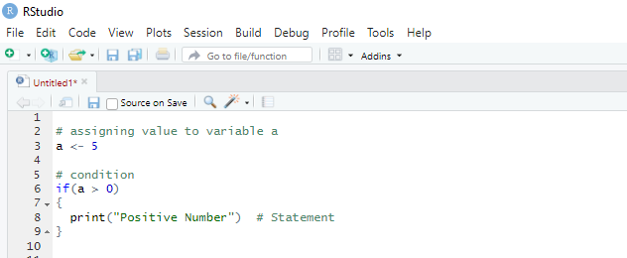
Introduction
The R statements are the Decision Making statements which help to decide whether to execute a block of code or not, based on a condition
R -If Statement
It is used to decide whether a certain statement or block of statements will be executed or not i.e if a certain condition is true then a block of statement is executed otherwise not.
Syntax:
if (expression) {
#statement to execute if condition is true
}

Slide 4
R –If...Else Statement
An if-else statement is a great tool for the developer trying to return an output based on a condition.
R syntax:
if (condition) {
Expr1
} else {
Expr2
}

Slide 5
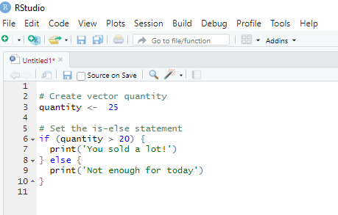
R –If...Else Statement
Example
We want to examine whether a variable stored as “quantity” is above 20.
If quantity is greater than 20, the code will print “You sold a lot!” otherwise Not enough for today.

Slide 6
The else if statement
We can further customize the control level with the else if statement.
With else if, you can add as many conditions as we want.
syntax:
if (condition1) {
expr1
} else if (condition2) {
expr2
} else if (condition3) {
expr3
} else {
expr4
}

Slide 7
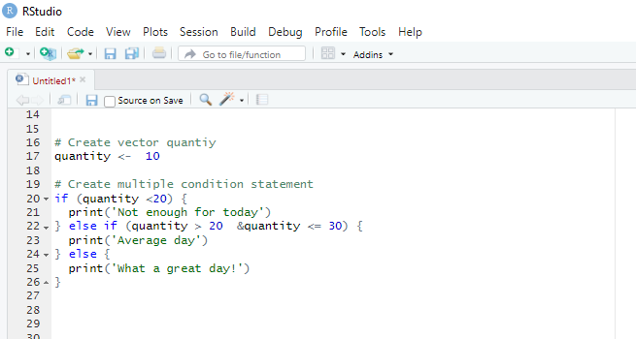
The else if statement
Example
We are interested to know if we sold quantities between 20 and 30.
If we do, then the pint Average day. If quantity is > 30 we print What a great day!, otherwise Not enough for today.

Slide 8
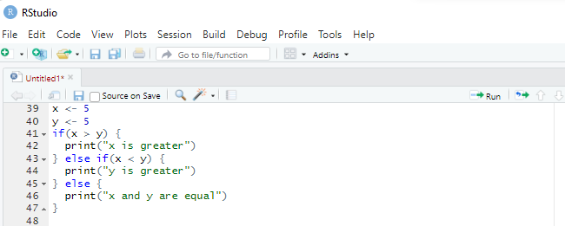
The if...else if...else Statement
An if statement can be followed by an optional else if...else statement, which is very useful to test various conditions using single if...else if statement.
When using if, else if, else statements there are few points to keep in mind.
An if can have zero or one else and it must come after any else if’s.
An if can have zero to many else if's and they must come before the else.
Once an else if succeeds, none of the remaining else if's or else's will be tested.

Slide 9
R –For Loop
A for loop is very valuable when we need to iterate over a list of elements or a range of numbers.
Loop can be used to iterate over a list, data frame, vector, matrix or any other object.
NB The braces and square bracket are compulsory.
For Loop Syntax:
For (value in vector) {
Exp
}

Slide 10
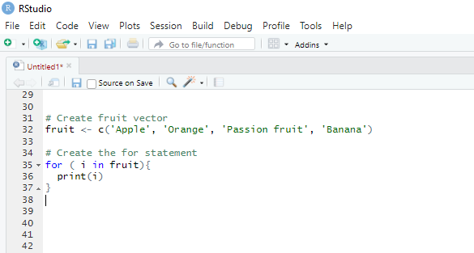
R –For Loop
Examples
We iterate over all the elements of a vector and print the current value

Slide 11
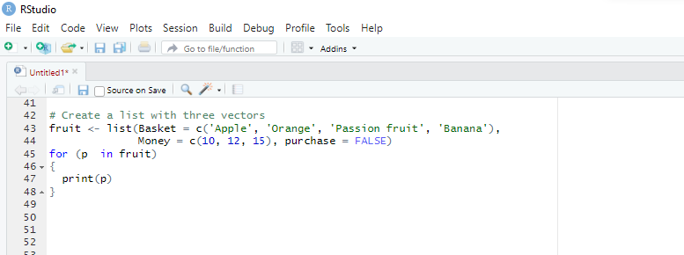
R –For Loop
Examples
For Loop over a list
Looping over a list is just as easy and convenient as looping over a vector

Slide 12
R -While Loop
A While loop in R programming is a statement that keeps running until a condition after while block is satisfied.
While Loop Syntax:
while (condition) {
Exp
Example
Let’s go through a very simple example to understand the concept of while loop. You will create a loop and after each run add 1 to the stored variable. You need to close the loop, therefore we explicitly tells R to stop looping when the variable reached 10.
Note: If you want to see current loop value, you need to wrap the variable inside the function print().

Slide 13
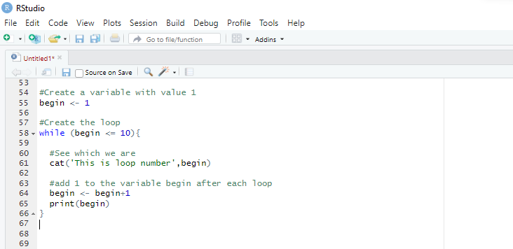
R -While Loop

Slide 14
LESSON 2
Data Import

Slide 15
Using apply-family functions
apply() function
apply() takes Data frame or matrix as an input and gives output in vector, list or array.
Apply function in R is primarily used to avoid explicit uses of loop constructs. It is the most basic of all collections can be used over a matrice.
This function takes 3 arguments:
apply(X, MARGIN, FUN)
Where:
-x: an array or matrix
-MARGIN: take a value or range between 1 and 2 to define where to apply the function:
-MARGIN=1`: the manipulation is performed on rows
-MARGIN=2`: the manipulation is performed on columns
-MARGIN=c(1,2)` the manipulation is performed on rows and columns
-FUN: tells which function to apply. Built functions like mean, median, sum, min, max and even user-defined functions can be applied>

Slide 16
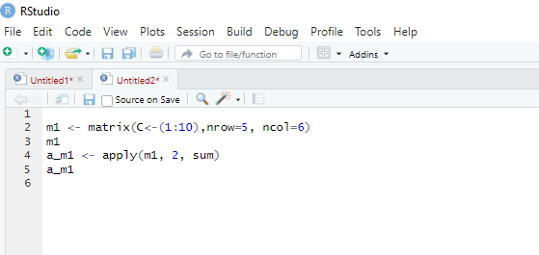
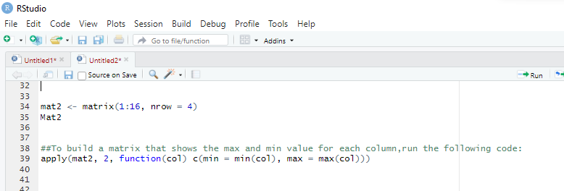
Using apply-family functions
Example
The simplest example is to sum a matrice over all the columns. The code apply(m1, 2, sum) will apply the sum function to the matrix 5×6 and return the sum of each column accessible in the dataset.

Slide 17
lapply() function
lapply() function is useful for performing operations on list objects and returns a list object of same length of original set.
lappy() returns a list of the similar length as input list object, each element of which is the result of applying FUN to the corresponding element of list.
Lapply in R takes list, vector or data frame as input and gives output in list.
lapply(X, FUN)
Arguments:
-X: A vector or an object
-FUN: Function applied to each element of x
l in lapply() stands for list. The difference between lapply() and apply() lies between the output return. The output of lapply() is a list. lapply() can be used for other objects like data frames and lists.
lapply() function does not need MARGIN.

Slide 18
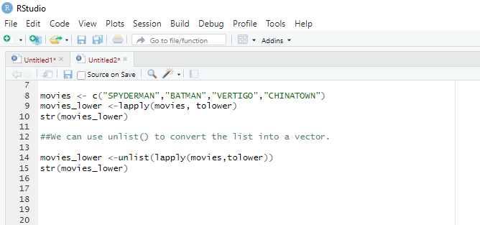
lapply() function
Example
To change the string value of a matrix to lower case with tolower function.
We construct a matrix with the name of the famous movies. The name is in upper case format.

Slide 19
sapply() function
sapply() function takes list, vector or data frame as input and gives output in vector or matrix.
It is useful for operations on list objects and returns a list object of same length of original set.
Sapply function in R does the same job as lapply() function but returns a vector.
sapply(X, FUN)
Arguments:
-X: A vector or an object
-FUN: Function applied to each element of x

Slide 20
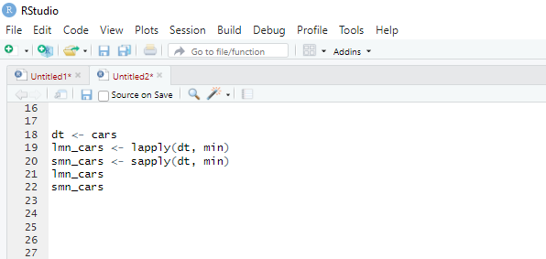
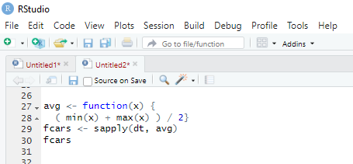
sapply() function
Example
We can measure the minimum speed and stopping distances of cars from the cars dataset.
We can use a user built-in function into lapply() or sapply().
We create a function named avg to compute the average of the minimum and maximum of the vector.

Slide 21
Difference between apply(), sapply() and `lapply()
Function | Arguments | Objective | Input | Output
apply | apply(x, MARGIN, FUN) | Apply a function to the rows or columns or both | Data frame or matrix | vector, list, array
lapply | lapply(X, FUN) | Apply a function to all the elements of the input | List, vector or data frame | list
sapply | sapply(X, FUN) | Apply a function to all the elements of the input | List, vector or data frame | vector or matrix

Slide 22
tapply() function
tapply() computes a measure (mean, median, min, max, etc..) or a function for each factor variable in a vector.
It is a very useful function that lets you create a subset of a vector and then apply some functions to each of the subset.
tapply(X, INDEX, FUN = NULL)
Arguments:
-X: An object, usually a vector
-INDEX: A list containing factor
-FUN: Function applied to each element of x
Part of the job of a data scientist or researchers is to compute summaries of variables. For instance, measure the average or group data based on a characteristic.

Slide 23
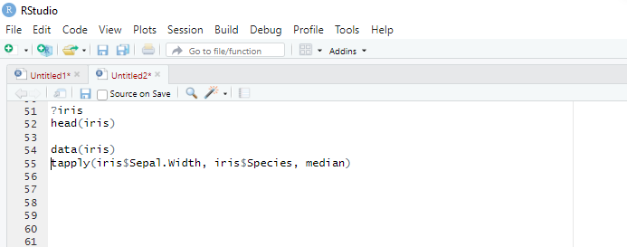
Example
Using the iris dataset.
This dataset is very famous in the world of machine learning. The purpose of this dataset is to predict the class of each of the three flower species: Sepal, Versicolor, Virginica. The dataset collects information for each species about their length and width.
Compute the median of the length for each species.
Tapply in R is a quick way to perform this computation.

Slide 24
Import data into R
Once your data are entered into Excel, OpenOffice, SPSS or whatever, we need a way to get the data file into a dataframe in R. The usual way to do this is to export the file from Excel/SPSS etc. in a format that R can import; however, the foreign package can be used to import directly data files from SPSS (.sav), STATA (.dta), Systat (.sys, .syd), Minitab (.mtp), and SAS (XPORT files). It is probably the safest (in terms of knowing that what you’re actually importing is what you think you’re importing), to export from your software of choice into an R-friendly format.
If we have saved the data as a CSV(comma-separated values) file, then we can import these data to a dataframe using the read.csv function. The general form of this function is:
dataframe.name<-read.csv("filename.extension", header = TRUE)
"C:\Users\USERNAME\Downloads\FILENAME.csv"
Note that, we should always specify the extension of the file name

Slide 25
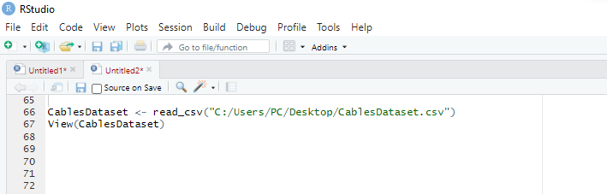
Import data into R

Slide 26
Import data into R cont…
Similarly, if you had saved the file as a tab-delimited text file from Excel (. txt) or SPSS (.sav), you could use the read.delim() function to import these files. This function takes the same form as the read.csv() function, except that you specify a tab-delimited file. Assuming you had set your working directory correctly, we would execute:
CablesDataset <-read.delim("CablesDataset", header = TRUE)
The file.choose() function
Some people really struggle with the idea of specifying file locations in R. This confusion isn’t a reason to be ashamed. the alternative is to use the choose. file() function.
Executing this function opens a standard dialog box allowing you to navigate to the file you want. You can incorporate this function into read.csv() and read.delim() as follows:
CablesDataset<-read.csv(file.choose(), header = TRUE)
CablesDataset<-read.delim(file.choose(), header = TRUE)
The effect that this has is that when you execute the command, a dialog box will appear and you can select the file that you want to import

Slide 27
Importing SPSS files directly
You can also import directly from SPSS data files (and other popular packages). To give you some practice, we have provided the data as a .sav file (CablesDataset.sav). First we need to install and load the package called foreign either using the menus or by executing these commands:
install.packages("foreign")
library(foreign)
The command to read in SPSS data files is read.spss() and it works in a similar way to the other import functions that we have already seen; however, there are a couple of extra things that we need to think about. First, let’s just execute the command to import our SPSS data file:
CablesDataset<-read.spss("CablesDataset.sav",use.value.labels=TRUE, to.data. frame=TRUE)
The basic format is the same as before: we have created a dataframe called CablesDataset, and we have done this from the file named CablesDataset.sav.
There are two additional instructions that we have used, the first is
use.value.labels = TRUE.
This command tells R that if a variable is set up as a factor or coding variable in SPSS then it should be imported as a factor. If you set this value to FALSE, then it is imported as a numeric variable
The second command is to.data. frame=TRUE, which self-evidently tells R to import the file as a dataframe. Without this command (or if it is set to FALSE), you get lots of horrible junk imported and nobody likes junk. Let’s have a look at the dataframe

Slide 28
Other Types of Data
To get other types of data into R, we recommend starting with the tidyverse packages listed next. They’re certainly not perfect, but they are a good place to start. For rectangular data
haven reads SPSS, Stata, and SAS files.
readxl reads Excel files (both .xls and .xlsx).
DBI, along with a database-specific backend (e.g., RMySQL, RSQLite, RPostgreSQL, etc.) allows you to run SQL queries against a database and return a data frame. Etc.

Slide 29
LESSON 3
Data Export and Missing Values

Slide 30
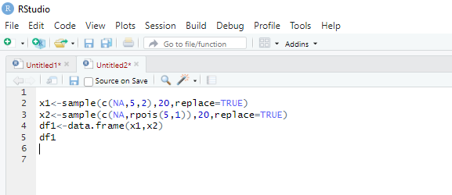
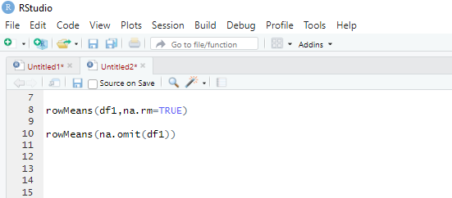
Na.omit & na.rm
The na.omit performs any calculation by considering the NA values but do not include them in the calculation.
On the other hand, na.rm remove the NA values and then perform any calculation.
For example, if a vector has one NA and 5 values in total then their sum using na.omit will be calculated by excluding NA and by using na.rm it will be calculated by removing NA.
Example
Finding row means using na.rm and na.omit −

Slide 31
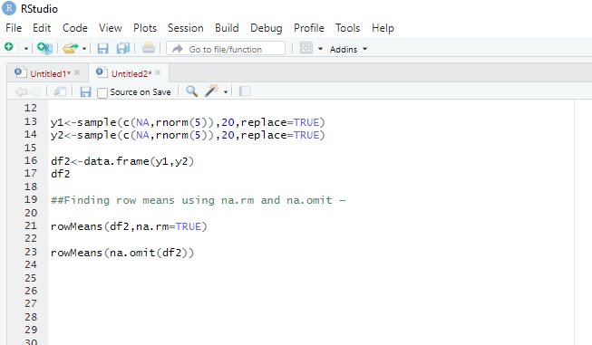
Na.omit & na.rm cont….

Slide 32
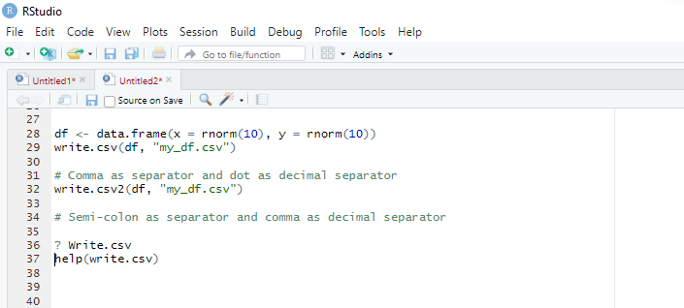
Export data from R R allows you to work with data and store it in variables in the workspace. However, sometimes you need to export or save to share or work with the results in other software.
Note that you can export data from R to several formats, like CSV, SAV, XLS, XLSX, TXT or even XML.
How to Export a Data Frame to a CSV File in R
In case you want to export a data frame as CSV in R, you can make use of the write.csv or write.csv2 functions.
The use of one or the other will depend on the format of your data. In some countries they use a comma as decimal separator, so you can’t save a CSV separated by commas in this scenario.
In this case, the CSV uses a semi-colon as separator of the data. The last is what the write.csv2 function does, while the write.csv uses a comma to separate the data.
Example

Slide 33
How to Export a Data Frame to a CSV File cont.. write.csv(df, “my_df.csv”): Create a CSV file in the hard drive:
df: name of the data frame in the environment
“table_df.csv”: Name the file table_df and store it as csv
Note: You can use the function write.csv in R as write.csv2() to separate the rows with a semicolon for R export to csv data.

Slide 34
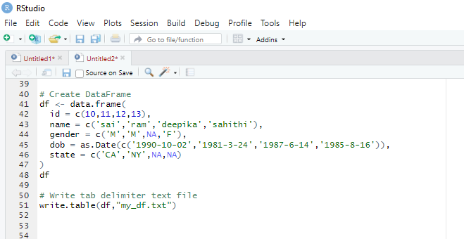
Export data from R to TXT file R base function has a write.table() function which is used to export the data frame data into a text file. This function takes several arguments that can be used to specify what and how you wanted to write.

Slide 35
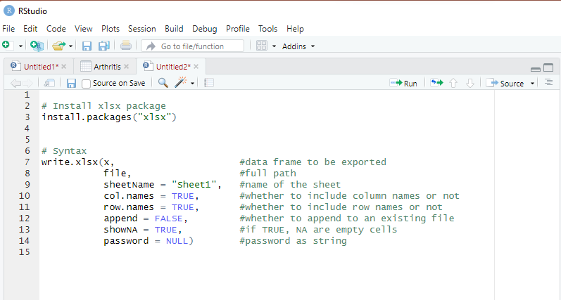
Export a Data from R to Excel File R use the library xlsx to create an Excel file.
write.xlsx() Syntax
The following is a syntax of the write.xlsx() function of xlsx package.
Comma separator and dot as decimal separator

Slide 36
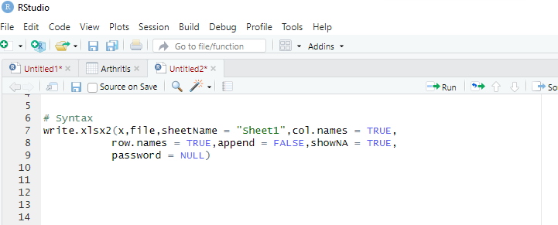
Export a Data from R to Excel File R use the library xlsx to create an Excel file.
write.xlsx2() Syntax
Semicolon separator and comma as decimal separator

Slide 37
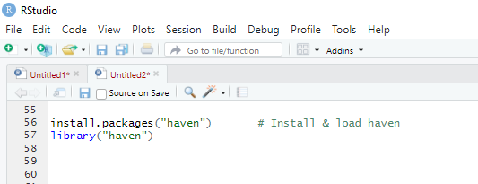
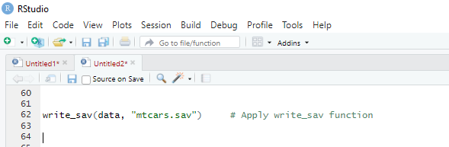
Export to SPSS from R
The R programming syntax below illustrates how to write our example data frame to an external .sav file on our computer.
For this, we first need to install and load the haven package:
Next, we can use the write_sav function of the haven package to store our data frame in a .sav file:

Slide 38
LESSON 4
Correlation

Slide 39
Correlation Analysis
Correlation test is used to evaluate the association between two or more variables.
Correlations between variables play an important role in a descriptive analysis.
A correlation measures the relationship between two variables, that is, how they are linked to each other.
In this sense, a correlation allows to know which variables evolve in the same direction, which ones evolve in the opposite direction, and which ones are independent.
For instance, if we are interested to know whether there is a relationship between the heights of fathers and sons, a correlation coefficient can be calculated to answer this question.

Slide 40
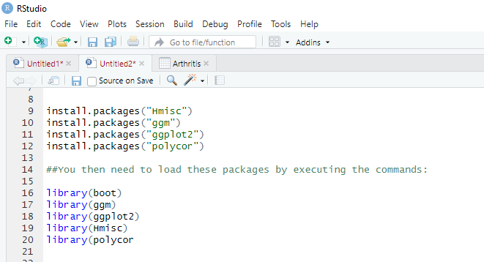
Bivariate Correlation
There are two types of correlation: bivariate and partial.
A bivariate correlation is a correlation between two variables whereas a partial correlation looks at the relationship between two variables while ‘controlling’ the effect of one or more additional variables.
Pearson’s product-moment correlation coefficient ,Spearman’s rho and Kendall’s tau (are examples of bivariate correlation coefficients.
There are several packages that we will use in this chapter. For the examples in this chapter you will need the packages Hmisc, polycor, boot, ggplot2 and ggm.
If you do not have these packages installed, you can install them by executing the following commands (boot is part of the base package and doesn’t need to be installed):

Slide 41
Correlation in R
Correlation coefficient can be computed using the functions cor() or cor.test():
cor() computes the correlation coefficient
cor.test() test for association/correlation between paired samples. It returns both the correlation coefficient and the significance level(or p-value) of the correlation .
We will look at each function in turn and see what parameters it uses. Let’s start with
cor(), which takes the general form:
cor(x,y, use = "string", method = "correlation type")
in which:
x is a numeric variable or dataframe.
y is another numeric variable (does not need to be specified if x above is a dataframe).
use is set equal to a character string that specifies how missing values are handled.
The strings can be:
“everything”, which will mean that R will output an NA instead of a correlation coefficient for any correlations involving variables containing missing values;
“all.obs”, which will use all observations and, therefore, returns an error message if there are any missing values in the data;
“complete.obs”, in which correlations are computed from only cases that are complete for all variables – sometimes known as excluding cases listwise or
(4) “pairwise. complete.obs”, in which correlations between pairs of variables are computed for cases that are complete for those two variables – sometimes known as excluding cases pairwise
Method is correlation method such as "pearson", "kendall", "spearman"

Slide 42
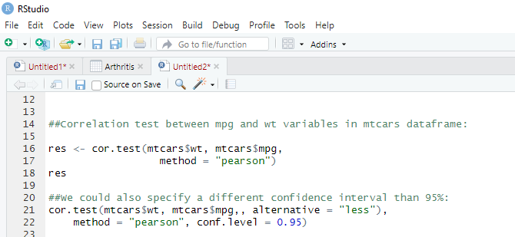
Example
t is the t-test statistic value
df is the degrees of freedom ,
p-value is the significance level of the t-test
conf.int is the confidence interval of the correlation coefficient at 95%,
sample estimates is the correlation coefficient
Pearson
Spearman
Kendall

Slide 43
Kendall’s Tau (non-parametric) Correlation
Kendall’s tau, τ, is another non-parametric correlation and it should be used rather than Spearman’s coefficient when you have a small data set with a large number of tied ranks.
This means that if you rank all of the scores and many scores have the same rank, then Kendall’s tau should be used.
Although Spearman’s statistic is the more popular of the two coefficients, there is much to suggest that Kendall’s statistic is actually a better estimate of the correlation in the population
As such, we can draw more accurate generalizations from Kendall’s statistic than from Spearman’s.
To carry out Kendall’s correlation on the WorldPhones data simply follow the same steps as for Pearson and Spearman correlations but use method = “kendall”

Slide 44
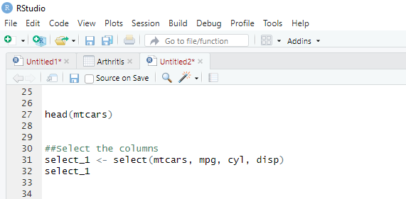
Dplyr select()
We will begin with the select() verb. We don’t necessarily need all the variables, and a good practice is to select only the variables you find relevant.
Great! Recall that if you want to keep the data you've selected, you can use assignment to create a new table.

Slide 45
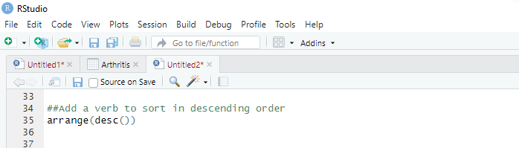
Arrange
In the previous work, you learnt how to sort the values with the function sort(). The library dplyr has its sorting function. It works like a charm with the pipeline. The arrange() verb can reorder one or many rows, either ascending (default) or descending.
- `arrange(A)`: Ascending sort of variable A
- `arrange(A, B)`: Ascending sort of variable A and B
- `arrange(desc(A), B)`: Descending sort of variable A and ascending sort of B

Slide 46
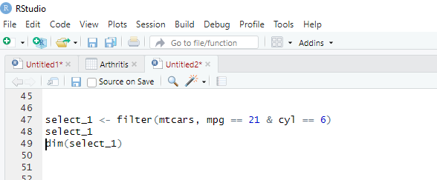
Filter
The filter() verb helps to keep the observations following a criteria. The filter() works exactly like select(), you pass the data frame first and then a condition separated by a comma
filter(df, condition)
arguments:
- df: dataset used to filter the data
condition: Condition used to filter the data

Slide 47
Aggregate()
Aggregate() Function in R Splits the data into subsets, computes summary statistics for each subsets and returns the result in a group by form.
Aggregate() function is useful in performing all the aggregate operations like sum, count, mean, minimum and Maximum.
Example
Aggregate() which computes group sum
calculate the group max and minimum using aggregate() function
Aggregate() function which computes group mean
Get group counts using aggregate() function
Syntax for Aggregate() Function in R aggregate(x, by, FUN, …, simplify = TRUE, drop = TRUE)
X an R object, Mostly a dataframe
By a list of grouping elements, by which the subsets are grouped by
FUN a function to compute the summary statistics
Simplify a logical indicating whether results should be simplified to a vector or matrix if possible
Drop a logical indicating whether to drop unused combinations of grouping values.

Slide 48
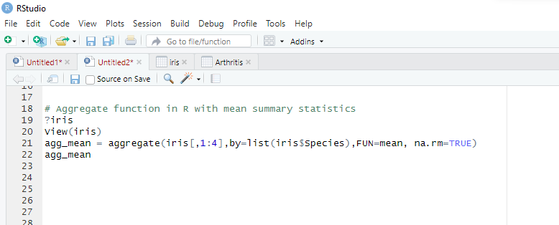
Example Let’s use the iris data set to demonstrate a simple example of aggregate function in R.
We all know about iris dataset. Suppose if want to find the mean of all the metrics
(Sepal.Length Sepal.Width Petal.Length Petal.Width) for the distinct species then we can use aggregate function
the above code takes first 4 columns of iris data set and groups by “species” by computing the mean for each group,
so the output will be
Note: when using the aggregate() function, the by variables must be in a list.

Slide 49
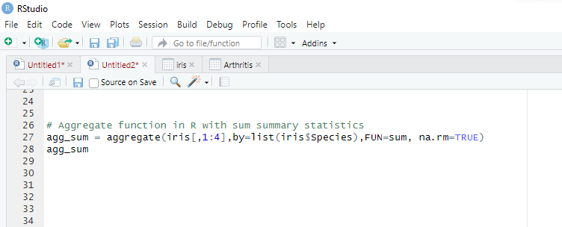
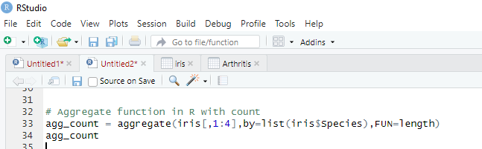
Example for aggregate() function in R with sum: Let’s use the aggregate() function in R to create the sum of all the metrics across species and group by species.
Example for aggregate() function in R with count: Let’s use the aggregate() function to create the count of all the metrics across species and group by species.
the above code takes first 4 columns of iris data set and groups by “species” by
computing the count for each group

Slide 50
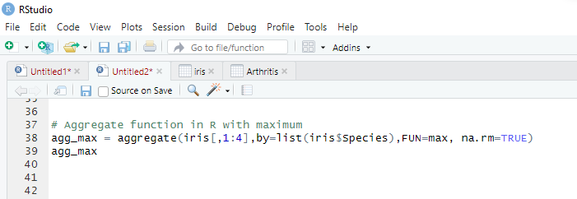
Example for aggregate() function in R with maximum: Let’s use the aggregate() function to create the maximum of all the metrics across species and group by species.
the above code takes first 4 columns of iris data set and groups by “species” by computing the max for each group

